Slide 1
Object Oriented Programming in Python
Eric Prebys

Slide 2
Definition of Object-Oriented Programming
From the web:
  Object-oriented programming (OOP) is a method of programming in which programs are structured as collections of interacting objects, each representing an instance of a class that defines its data and the operations that can be performed on that data.
Lexicon:
  “class”: This is a template for the object we want to create
  “data”: Data associated with the class
  “method”: This is a routine defined within the class
  “instance”: This is an object that is created based on a defined class. I can create many objects from one class definition and organize them in any way I like, including as part of other classes.
  ”inheritance”: Creating a new class based on one or more existing classes, generally to increase its functionality.

Slide 3
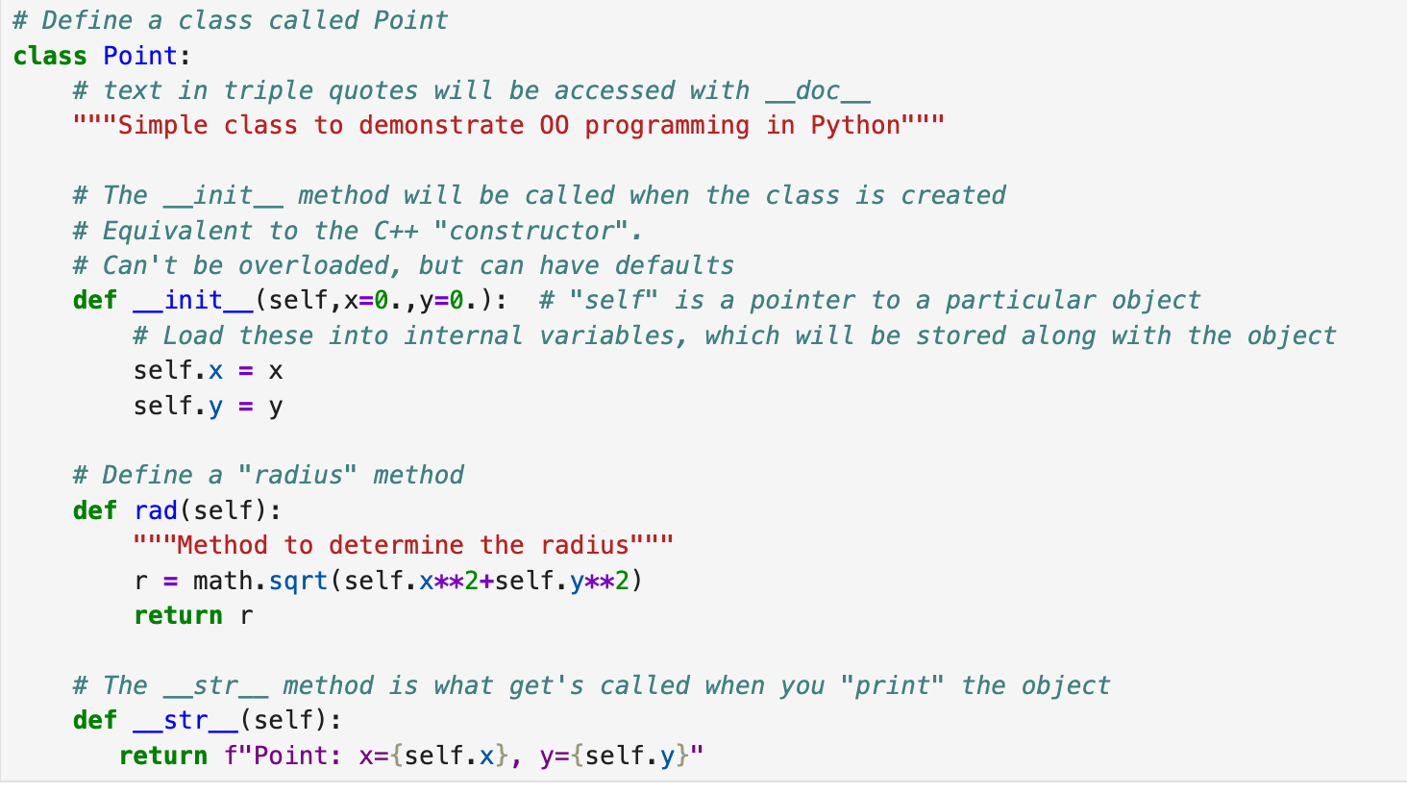
Simple Example: 2D Point class
“self” is a pointer to the current instance.
It’s automatically added at the beginning when you call a method.
You use it to point to the data associate with the current instance
(go to ”Lecture 6 – OO.ipynb”)

Slide 4
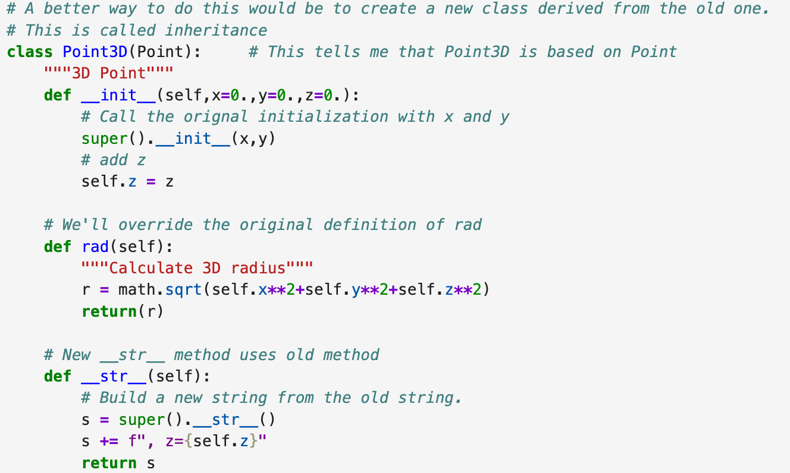
Inheritance
We can create a new class based on an old class. In this case, we create a Point3D class

Slide 5
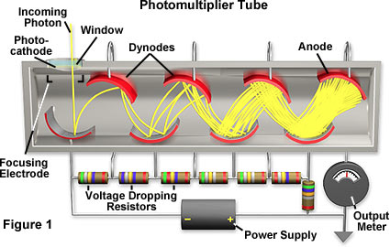
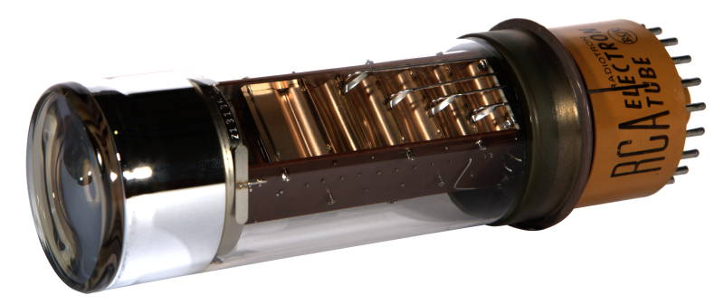
Digression: Photomultiplier Tubes
Photomultiplier tubes are one of the oldest types of particle detectors.
They use a series of “dynodes” to amplify the photoelectron ejected by a single photon until it’s a measurable signal.
If I want precision, I need to calibrate each PMT and correct the ”raw” data as
calibrated_value = offset+gain*raw_value

Slide 6
Our Example Project
We’re going to define a “PMT” class, which stores the following for each PMT
  Unique ID number
  Location:
  Offset and Gain
It will include methods to
  Load raw readout data
  Check to see of readout data is there
  Convert raw data to calibrated data
  Clear the readout data once I’m done.
We’re then going to use the class to generate a 10x10 array of PMTs and do a simulated readout.

Slide 7
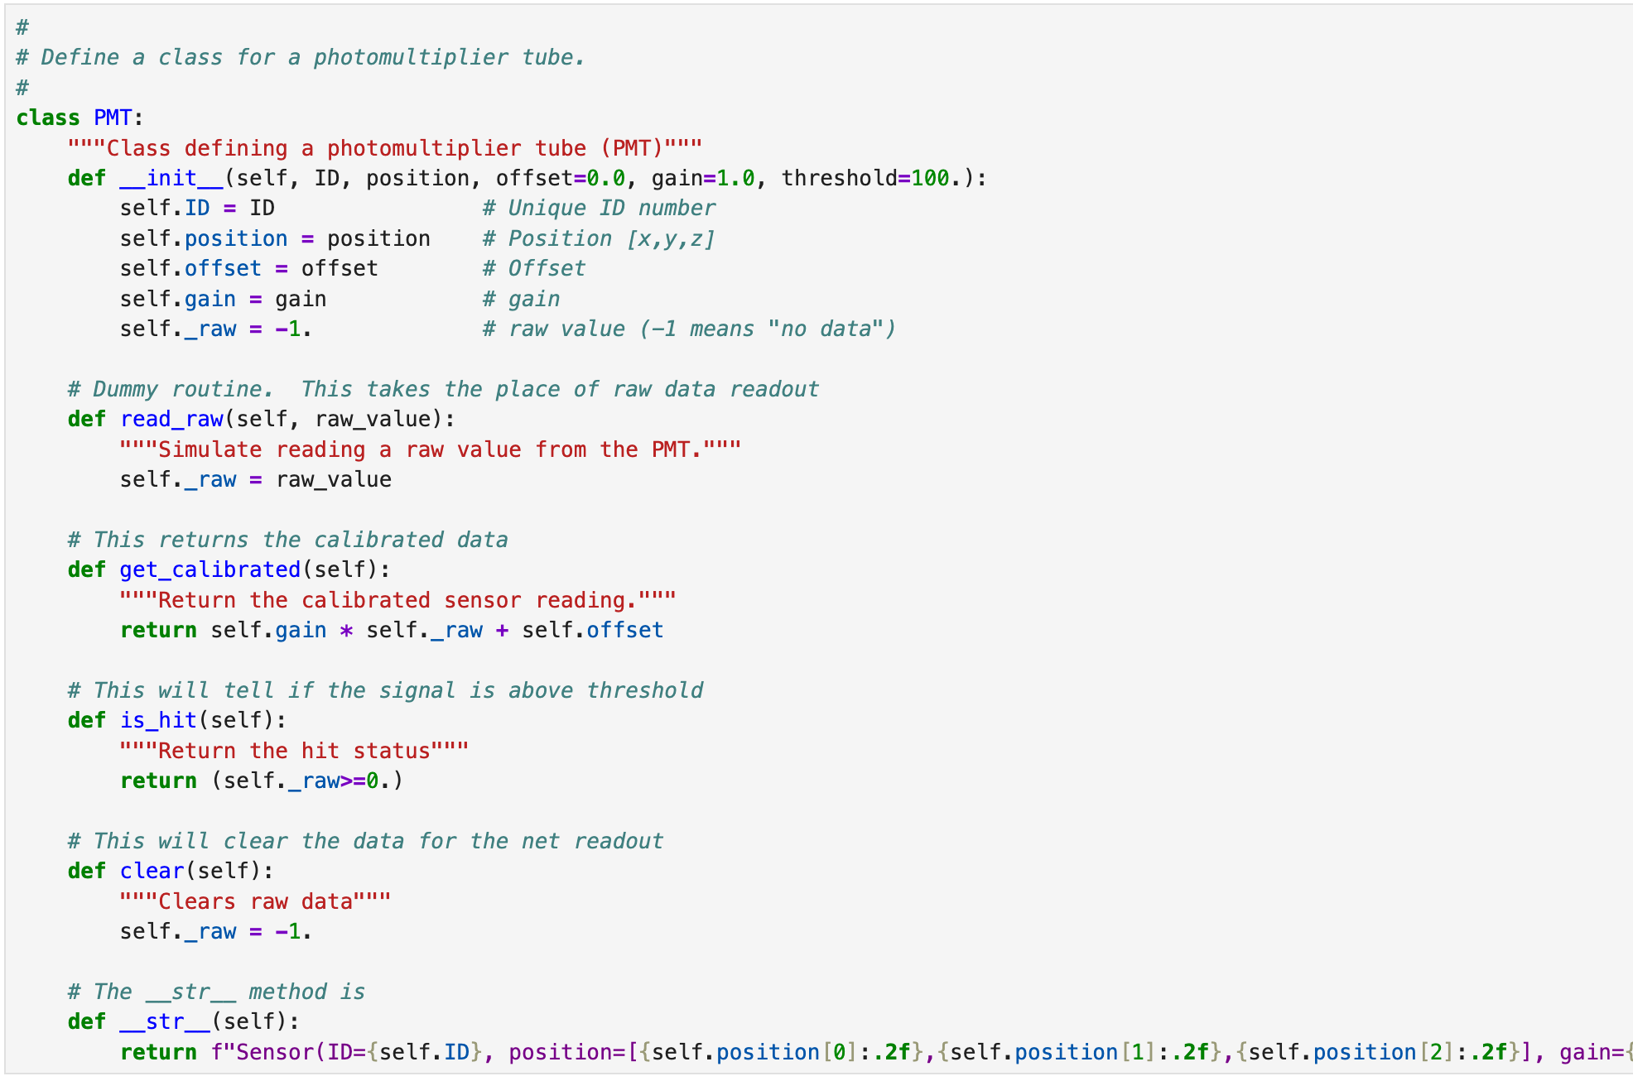
(go to ”Lecture 6 – PMT Example.ipynb”)

